Slide 1
Manipulating Pictures, Arrays, and Loops part 3
Barb Ericson
Georgia Institute of Technology
May 2006

Slide 2
Learning Goals
Understand at a conceptual and practical level
  What is an algorithm?
  What is a program?
  How to translate an algorithm to code
  What is a comment?
  What happens if you multiply by 0.5 instead of divide by 2?
  How to improve a method

Slide 3
Changing from For-each to While
In a for-each loop something needs to keep track of the current pixel
  And change each time through the loop
  To sure that we have gone through all of the pixels
We can loop through all elements in an array by starting with index 0, then index 1, and so on till index (length – 1)
  And get the pixel at the current index value

Slide 4
Reduce Red Algorithm
Get the array of Pixel objects from the current picture
Declare a variable to hold the red value
Declare the index variable and set it to 0
Declare a variable to refer to the current pixel
Loop while index is less than the length of the array
  Get the pixel at the index value
  Get the current red value from the pixel
  Divide the current red value by 2
  Set the red for the current pixel to the changed value
  Increment the index
Notes:
The items in blue are what is different from the for-each loop version.

Slide 5
Loop Algorithm to Code
How to write (code) the loop?
  Use a while loop with a counter for the index starting at 0
    int index = 0;
  Add a variable to refer to the current pixel
    Pixel pixelObj = null;
  Loop while the index is less than the length of the array
    while (index < pixelArray.length)
  Get the current pixel from the array of pixels for the current index
    pixelObj = pixelArray[index];

Slide 6
Loop Algorithm to Code - Continued
  Get the red value at the pixel
    value = pixelObj.getRed();
  Divide the red value by 2
    value = value / 2;
  Set the pixel red value
    pixel.setRed(value);
  Add one to (increment) the index
    index = index + 1;

Slide 7
Decrease Red Method
public void decreaseRed()
{
Pixel[] pixelArray = this.getPixels();
int value = 0;
Pixel pixelObj = null;
int index = 0;
// loop through all the pixels
while(index < pixelArray.length)
{
// get the current pixel
pixelObj = pixelArray[index];
// get the red value
value = pixelObj.getRed();
// decrease the red value
value = value / 2;
// set the pixel red
pixelObj.setRed(value);
// increment the index
index = index + 1;
}
Notes:
We declare items that we will need in the loop before the loop so that new ones don't get created each time through the loop.

Slide 8
Method Names
If we add this new method to Picture.java and compile will we get an error?
  We will have two methods with the same name and both take no parameters
  We can have two methods with the same name
    As long as the parameter list is different
We need to name one of them differently
  Rename the first one to decreaseRedForEach

Slide 9
Comments
Comments are explanations of your code to help people understand your code
  They are ignored by the compiler
There are several kinds in Java
  // a comment that lasts to the end of the line
  /* a comment that can take up several lines
  until a */
  /** a Javadoc comment that is used to create html documentation of your code */
Notes:
Javadoc is a utility that comes with the JDK for creating html documentation from your source code (*.java files).

Slide 10
Decrease Red Exercise
In DrJava
  Add the method decreaseRed() to Picture.java
    Before the last } which ends the class definition
  Compile the method
    Click the Compile All button
  Test it by doing the following in the interactions pane
    > String fileName = "C:/intro-prog-java/mediasources/caterpillar.jpg";
    > Picture picture1 = new Picture(fileName);
    > picture1.explore();
    > picture1.decreaseRed();
    > picture1.explore();
Notes:
Use the picture explorer to check that the red values where reduced by 50%.

Slide 11

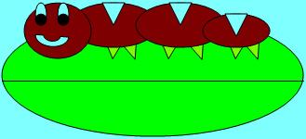
decreaseRed Method Result
Before method
After method

Slide 12
Using Multiplication by 0.5
You could have also multiplied the red value by 0.5 and then cast back to integer
  value = value * 0.5;
Change the line that divided by 2 and try to compile this
  In the decreaseRed method

Slide 13
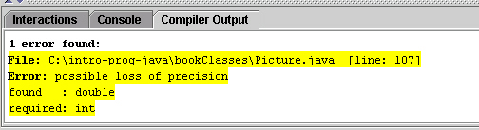
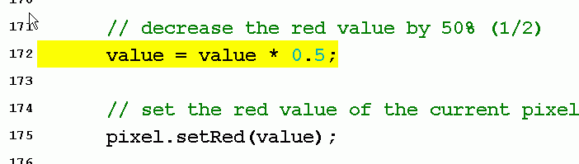
Loss of Precision
If you try the code on the previous slide you will get a compiler error
  Possible loss of precision
It is complaining about putting a double value into a int variable
  Loss of fractional part
Notes:
Double clicking on an error in the Compiler Output pane will highlight the statement that caused the error and change the definitions pane to show you the problem.

Slide 14
Casting to Solve Loss of Precision Error
It will compile if we tell the compiler we know about the possible loss of precision
  And that it is intended
    By using a cast to int
      value = (int) (value * 0.5);
    Notice that we cast the result of the multiplication back to an integer
Casting is forcing a value into a type
  (type) expression

Slide 15
Put Declarations Outside Loops
When you need a variable in a loop it is best to declare it before the loop
  Otherwise you are declaring a new variable each time through the loop
    Which is slower than just changing the value associated with the variable
In some languages you must declare all variables at the beginning of a method (function)
In Java you can declare variables anywhere in a method
  As long as you declare them before you use them
  They are known in the block they are declared in

Slide 16
Shortcuts for Common Operations
In programming you often need to add one to a value
  index = index + 1;
You may use the shortcut
  index++; or ++index;
If you wanted to subtract 1 instead
  index = index – 1;
  index--; or -- index;
Notes:
You can also use x += y as a shortcut for x = x + y, x-=y for x = x – y, x*=y for x=x*y, and x/=y for x = x / y.

Slide 17
Summary
An algorithm is a description of how to solve a problem
A program implements an algorithm in a programming language
A comment is an explanation of your code to help people understand it
  Comments are ignored by the computer
If you multiply by a floating point number you can’t put this in an integer variable
  Unless you cast to integer
You should declare variables before the body of the loop
  That you will need in the loop

